Slide 1
NYC Public SCHools: inflated graduation rates, but a low college readiness index
Michelle Cronin
GA - DAT30
Quick Draft Presentation – March 2, 2016

Slide 2
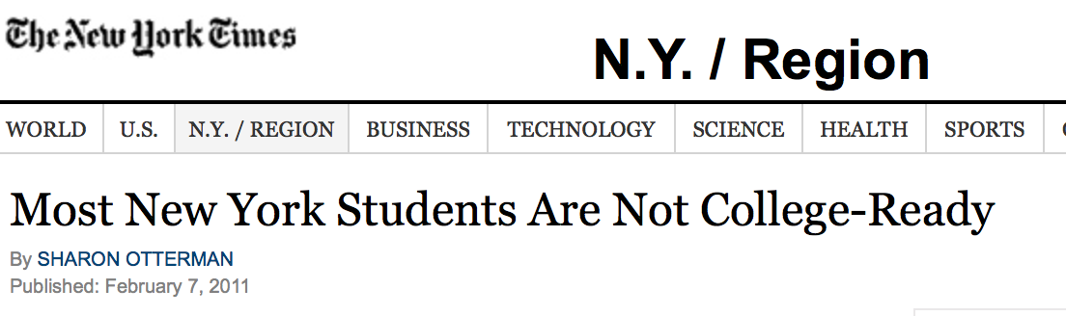

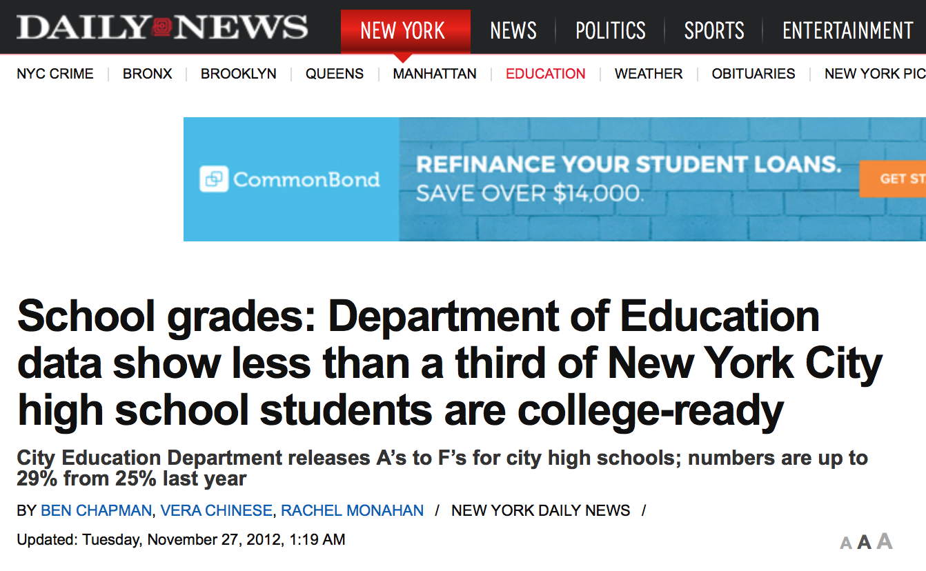
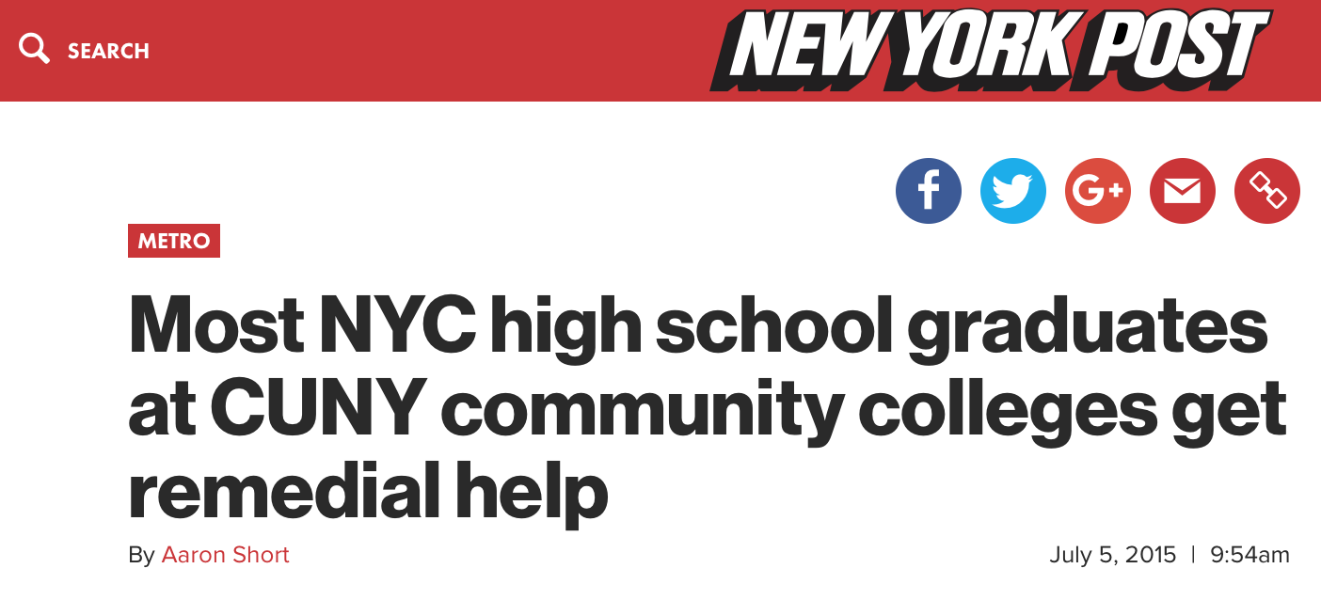
THE ISSUE
Several articles have come out recently pointing out that although graduation rates in NYC public schools have risen over the years, the rate of students prepared for college has remained low
Thus, NYC public schools are graduating many students each year who are not considered college-ready

Slide 3
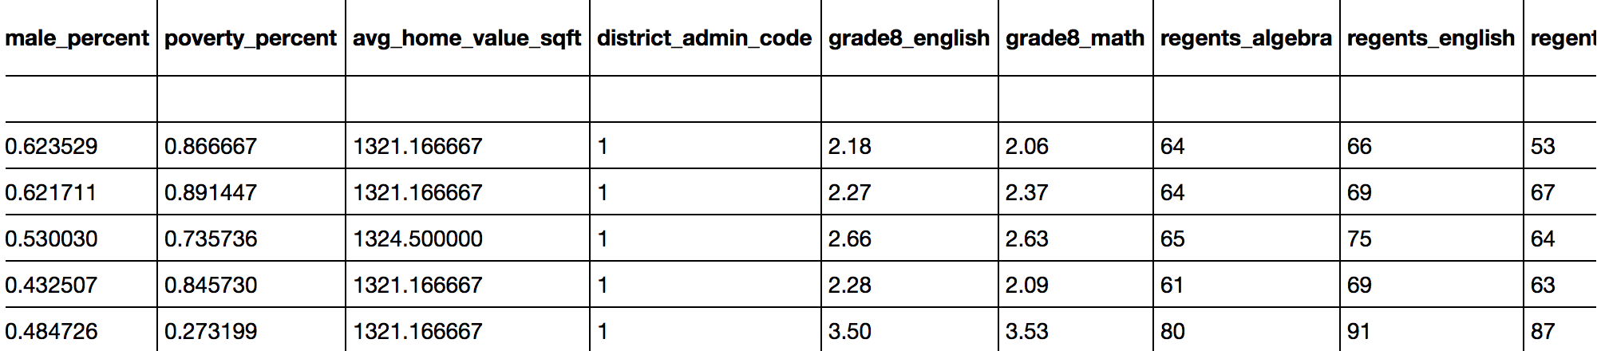
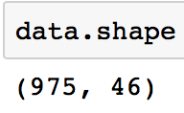
What data have I gathered, and how did I gather it?
Mostly measurable characteristics of NYC public high schools (performance, demographics, location, etc.) from NYC Open Data and the Department of Education:
2013_2014_HS_SQR_Results_2015_03_02.xlsx
2014_2015_HS_SQR_Results_2016_01_07.xlsx
DemographicSnapshot201011to201415Public_FINAL-2.xlsx
2015 Graduation_Rates_Public_School-2.xlsx- DOE_High_School_Directory_2013-2014.csv
DOE_High_School_Directory_2014-2015.csv- 2014 Public Data File SUPPRESSED.xlsx
2015 Public Data File.xlsx- Location_Information_Report.csv
Zip_MedianValuePerSqft_AllHomes.csv

Slide 4

Which areas of the data have I cleaned, and which areas still need cleaning?
Done:
Dropped and imputed missing values
Feature Selection – Necessary due to overlapping features in sources as well as presence of irrelevant features
Some Feature Engineering:
Length of School Day (End of day – Start of day)
Diversity Score (Sum of the squared reported race/ethnicity percents [black, white, Hispanic, Asian])
Overall SAT score (Reading SAT + Writing SAT + Math SAT average scores)
Overall Regents score (Algebra + English + Living Environment + Global History Regents average scores)
Grade 8 Proficiency score (Grade 8 Math + Grade 8 English scores)
Tidied the names
To Do:
Dummy categorization (Zip codes and/or Administrative districts)
Possibly more feature selection

Slide 5
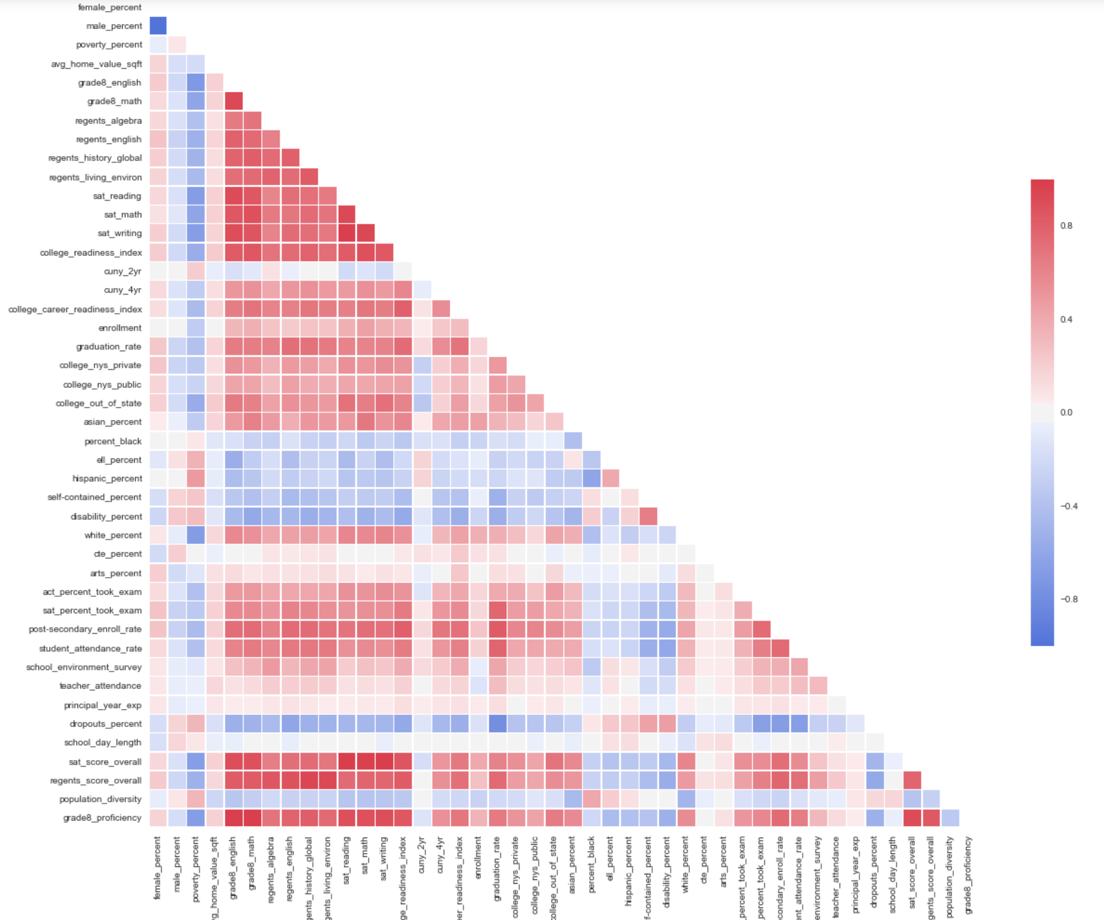
What steps have I taken to explore the data?
Created visuals to look at correlation (heatmap) and missing values
Very unclean data → so most EDA thus far has been targeted at cleaning it
Explored feature variance
Looked for outliers

Slide 6

What insights have I gained from My exploration?
High school’s graduation rate and college readiness index share high correlation with the following features (in varying strengths):
Post-Secondary enrollment rate
Student Attendance Rate
Percentage of students who take the SAT
Overall Regents score
Grade 8 Proficiency Scores
Average graduation rate for 2014 and 2015 combined: 73.34%
Standard Deviation: 0.160871
Average college readiness index for 2014 and 2015 combined: 29.05%
Standard Deviation: 0.232938

Slide 7

Will I be able to answer MY question with this data, or do I need to gather more data (or adjust MY question)?
Yes, I am fairly confident that I will be able to answer my question with this data
Potential problem: very unbalanced class

Slide 8

How might I use modeling to answer MY question?
Random Forest
Protect against variance (great because I have a considerable amount of features, and they’re still growing)
Will tell me most important features
Logistic Regression
Lasso/ridge will drop/let me know unimportant features
Will allow me to view feature coefficients
k-means Clustering:
I may be able to discover distinguishable groups of schools to find some counterintuitive combinations of characteristics as well as obvious ones

